Slide 1
Introduction to Social Networking Research Topics

Slide 2
Research Issues
Community Analysis
Trust and Distrust Propagation
Privacy Preserving
Information Diffusion
Link Analysis

Slide 3
Community Analysis in Social Networks

Slide 4
Outline
What ?
Why ?
How ?
to obtain the structure
to evaluate the identified result

Slide 5
Community structure
groups of vertices within which connections are dense but between which they are sparser.
a.k.a. group, community, cluster, module in different contexts
Within-group( intra-group) edges.
High density
Between-group( inter-group) edges.
Low density.
Notes:
Difference between clustering and community structure detection.
Clustering is dividing the data points into classes according to some similarity measure.
Community structure: dividing the network into groups according to structural info.( connectivity).

Slide 6
Community structure

Slide 7
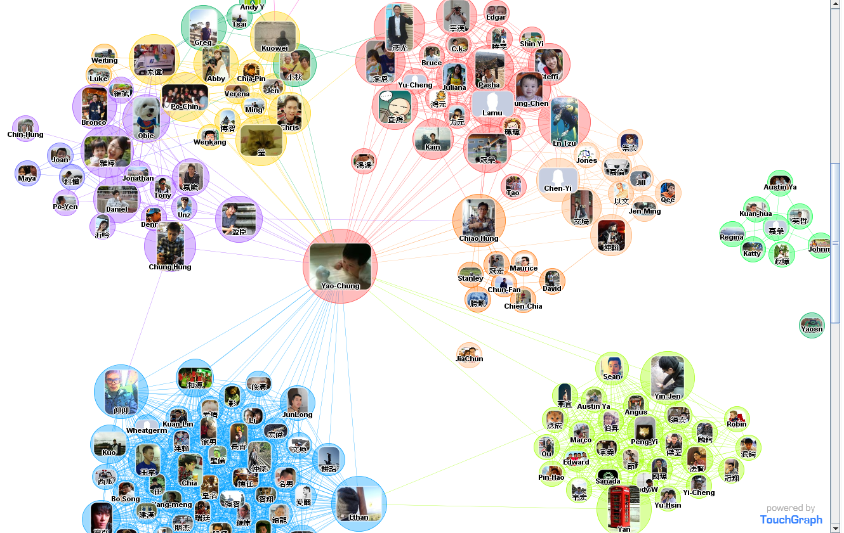

Slide 8
Community
Two types of groups in social media
Explicit Groups: formed by user subscriptions
Implicit Groups: implicitly formed by social interactions
Network interaction provides rich information about the relationship between users
Can complement other kinds of information, e.g. user profile
Help network visualization and navigation
Provide basic information for other tasks, e.g. recommendation

Slide 9
Community Structures Applications
Communities of biochemical network correspond to functional units of some kind.
Communities of a web graph correspond to sets of web sites dealing with a related topics.

Slide 10
The objective
Divide the network into non-empty groups (communities) in such a way that every vertex belongs to one of the communities.
Many possible divisions could be done.
We need a good division.
Measurement of good division.

Slide 11
Community Detection Algorithms
Graph partitioning Algorithm
The Clique Percolation Method
The Kernighan-Lin (KL) algorithm
Block Model Algorithm
Structural Similarity Algorithm
Edge Removal Algorithm
Randomized Algorithm

Slide 12
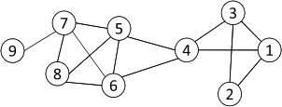
Cliques
Nodes 5, 6, 7 and 8 form a clique
12
Maximum Clique: a maximum complete subgraph in which all nodes are adjacent to each other
Straightforward implementation to find cliques is very expensive in time complexity

Slide 13
Clique Percolation Method (CPM)
Clique is a very strict definition
Normally use cliques as a core or a seed to find larger communities
CPM is a method to find overlapping communities
Input
A parameter k, and a network
Procedure
Find out all cliques of size k in a given network
Construct a clique graph. Two cliques are adjacent if they share k-1 nodes
Each connected components in the clique graph form a community

Slide 14
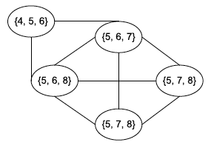
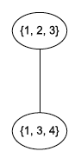
CPM Example
Cliques of size 3:
{1, 2, 3}, {1, 3, 4}, {4, 5, 6}, {5, 6, 7}, {5, 6, 8}, {5, 7, 8},
{6, 7, 8}
Communities:
{1, 2, 3, 4}
{4, 5, 6, 7, 8}

Slide 15
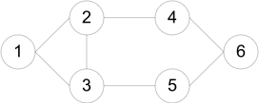
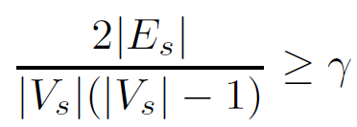
Many Variants of CPM method
k-clique: a maximal subgraph in which the largest distance between any two nodes <= k in the original graph
k-club: a substructure of diameter <= k
Clique is a very strict definition
A subgraph is a quasi-clique if
where the denominator is the maximum number of degrees.
Cliques: {1, 2, 3}
2-cliques: {1, 2, 3, 4, 5}, {2, 3, 4, 5, 6}
2-clubs: {1,2,3,4}, {1, 2, 3, 5}, {2, 3, 4, 5, 6}

Slide 16
Community Detection Algorithms
Graph partitioning Algorithm
The Clique Percolation Method
The Kernighan-Lin (KL) algorithm
Structural Similarity Algorithm
Edge Removal Algorithm
Randomized Algorithm
Notes:
Graph partitioning is iterative bisection: dividing the graph into 2 groups and then subdivide each group until we have the required # of groups.

Slide 17

Cut !!!!

Slide 18
Cut
Most interactions are within group whereas interactions between groups are few
community detection → minimum cut problem
Cut: A partition of vertices of a graph into two disjoint sets
Minimum cut problem: find a graph partition such that the number of edges between the two sets is minimized

Slide 19
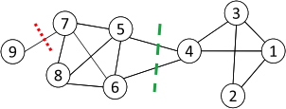
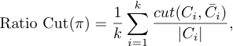
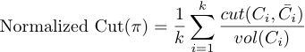
Ratio Cut & Normalized Cut
Minimum cut often returns an imbalanced partition, with one set being a singleton, e.g. node 9
Change the objective function to consider community size
C_{i,}: a community
|C_{i}|: number of nodes in C_{i}
vol(C_{i}): sum of degrees in C_{i}
k = 分幾群
Vol(Ci) = cut後各群每個node加總的degrees

Slide 20
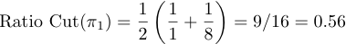
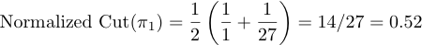
Ratio Cut & Normalized Cut Example
For partition in red:
For partition in green:
Both ratio cut and normalized cut prefer a balanced partition

Slide 21
KL algorithm

Slide 22
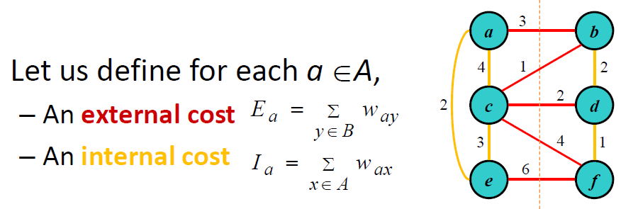
Kernighan-Lin (KL) algorithm
A
B
Let D_{z}=E_{z}‐I_{z} for a node z;
D_{z} is the difference between its external and internal costs for node z

Slide 23
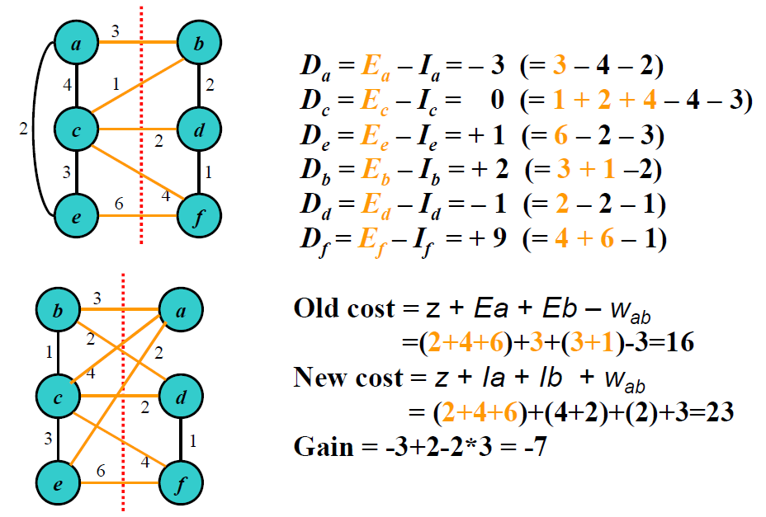
Kernighan-Lin (KL) algorithm

Slide 24
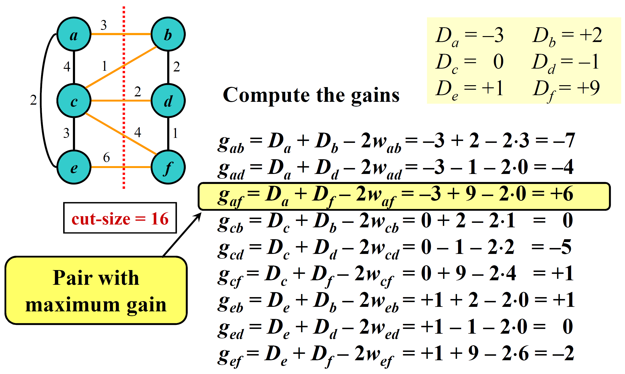
Kernighan-Lin (KL) algorithm

Slide 25
Kernighan-Lin (KL) algorithm

Slide 26


Slide 27
Community Detection Algorithms
Graph partitioning Algorithm
The Clique Percolation Method
The Kernighan-Lin (KL) algorithm
Structural Similarity Algorithm
Edge Removal Algorithm
Randomized Algorithm
Notes:
Graph partitioning is iterative bisection: dividing the graph into 2 groups and then subdivide each group until we have the required # of groups.

Slide 28
Clustering based on Vertex Similarity
Apply k-means or similarity-based clustering to nodes
Vertex similarity is defined in terms of the similarity of their neighborhood
Structural equivalence: two nodes are structurally equivalent iff they are connecting to the same set of actors
Nodes 1 and 3 are structurally equivalent;
So are nodes 5 and 6.

Slide 29
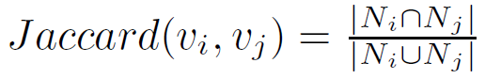
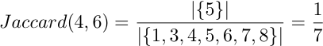
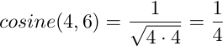
Vertex Similarity
↑cosine 相似度
Jaccard Similarity
Cosine similarity

Slide 30
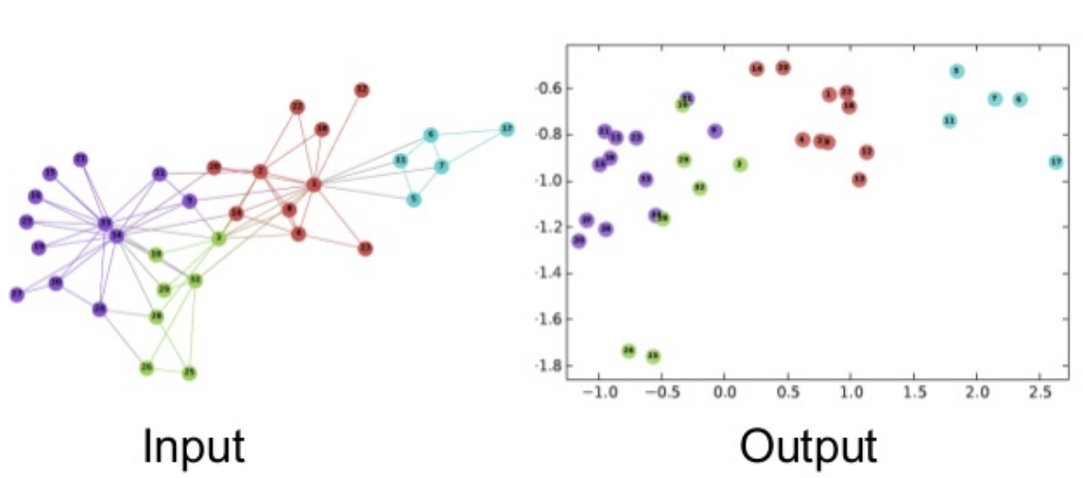
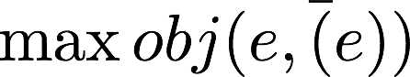
Vertex Embedding
B
A
C
D
E
相連的node數字要越大越好，反之要越小越好
If A(1,1) B(-1,1) C(-1,-1)
(A,B) = 1 / 1 + (1 / (e ^ ((1*-1) + (1*1))) = ½
(B,C) = 1 / 1 + (1 / (e ^ ((-1*-1) + (1*-1))) = ½
(A,C) = 1 / 1 + (1 / (e ^ ((1*-1) + (1*-1))) = 1/ (1 + 1/e^2)
= 0.11
If A(1,1) B(-1,-1) C(-1,1)
(A,B) = 0.11
(B,C) = ½
(A,C) = ½
½+½-0.11 = 0.89 > 0.11+½-½ = 0.11
左邊擺法好
↑sigmoid function(介於0~1之間)

Slide 31
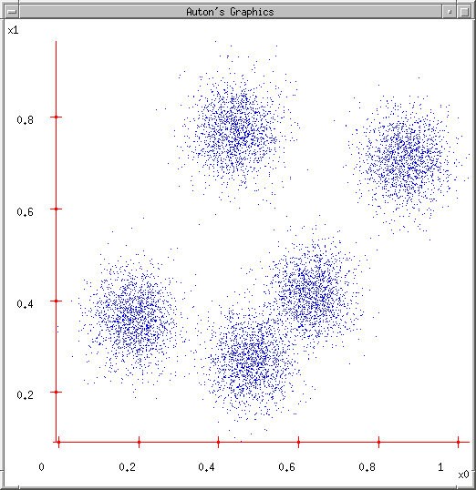
K-means illustration
User set up the number of clusters they’d like. (e.g. k=5)

Slide 32
K-means illustration
User set up the number of clusters they’d like. (e.g. K=5)
Randomly guess K cluster Center locations

Slide 33
K-means illustration
User set up the number of clusters they’d like. (e.g. K=5)
Randomly guess K cluster Center locations
Each data point finds out which Center it’s closest to. (Thus each Center “owns” a set of data points)

Slide 34
K-means illustration
User set up the number of clusters they’d like. (e.g. K=5)
Randomly guess K cluster centre locations
Each data point finds out which centre it’s closest to. (Thus each Center “owns” a set of data points)
Each centre finds the centroid of the points it owns

Slide 35
K-means illustration
User set up the number of clusters they’d like. (e.g. K=5)
Randomly guess K cluster centre locations
Each data point finds out which centre it’s closest to. (Thus each centre “owns” a set of data points)
Each centre finds the centroid of the points it owns
…and jumps there

Slide 36
K-means illustration
User set up the number of clusters they’d like. (e.g. K=5)
Randomly guess K cluster centre locations
Each data point finds out which centre it’s closest to. (Thus each centre “owns” a set of data points)
Each centre finds the centroid of the points it owns
…and jumps there
…Repeat until terminated!

Slide 37
Community Detection Algorithms
Graph partitioning Algorithm
The Clique Percolation Method
The Kernighan-Lin (KL) algorithm
Block Model Algorithm
Structural Similarity Algorithm
Edge Removal Algorithm
Randomized Algorithm
Notes:
Graph partitioning is iterative bisection: dividing the graph into 2 groups and then subdivide each group until we have the required # of groups.

Slide 38
Edge Removal Algorithm

Slide 39
Edge Removal Algorithm
從圖中找出可以分成兩群的點
By defining a measure to rank the nodes
By degree ?
By clustering coefficient ?
By betweeness ?
Betweeness : 隨機找點算最短路進是否都經過我

Slide 40
By Detweeness
ratio of the number of shortest paths passing through a node v out of all shortest paths between all node pairs in a network
betweenness of vertex i
shortest paths between j and k that pass through i
all shortest paths between j and k
i
k
j

Slide 41
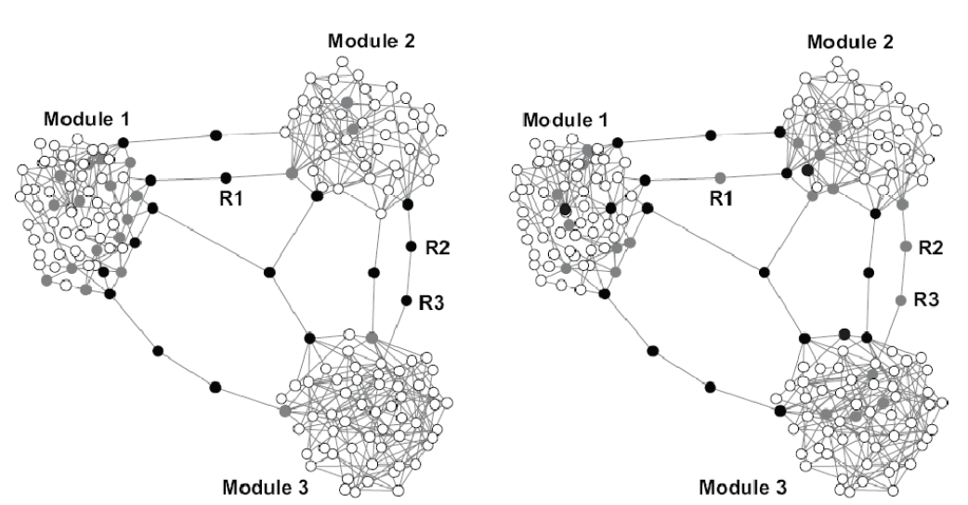
By Detweeness ?

Slide 42
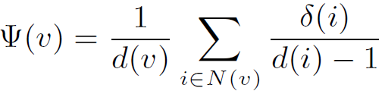
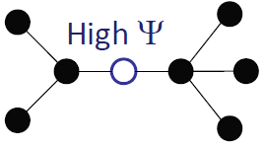
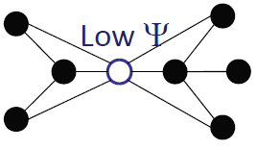
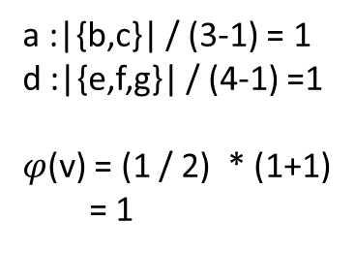
Bridging coefficient
以V點來說 計算它的鄰居點
這些鄰居點彼此的關聯要越低越好
δ(i) = |N(i)-N(v)-v|
For node v:
The average probability of leaving the direct neighbor sub-graph of a node v.
Δ(A) = |N(a) – N(v) - v|
= |{b,c,v} – {a,d} - v|
= |{b,c}| = 2
幾個鄰居
Δ(d) = |{v,e,f,g}| - {b,c,a,e,f,d} - v|
= |{g}| = 1
d = 1/(4 – 1) = 1/3
a :|{b,c}| / (3-1) = 1
d :|{e,f,g}| / (4-1) =1
$φ$(v) = (1 / 2) * (1+1)
= 1
e
e
b
f
b
v
f
a
v
d
a
v
d
g
c
c
g
Bridging Coefficient: a measurement that measuring the extent how well a node or edge is located between well connected regions.

Slide 43
Experiment
Bridging centrality
Betweenness centrality

Slide 44
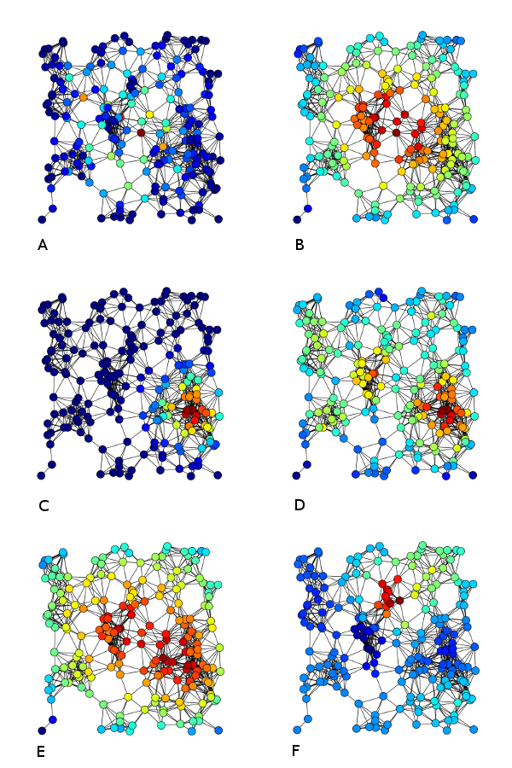
Examples of
A) Betweenness centrality,
B) Closeness centrality,
C) Eigenvector centrality,
D)Degree centrality,
E) Harmonic centrality
F) Katz centrality of the same graph

Slide 45
Edge Betweenness
The edge betweenness of e(1, 2) is 4 (=6/2 + 1), as all the shortest paths from 2 to {4, 5, 6, 7, 8, 9} have to either pass e(1, 2) or e(2, 3), and e(1,2) is the shortest path between 1 and 2
45
The strength of a tie can be measured by edge betweenness
Edge betweenness: the number of shortest paths that pass along with the edge
The edge with higher betweenness tends to be the bridge between two communities.
Notes:
Nodes 4-9 have two paths to reach Node2: e(1,2) and e(2,3), hence, 6/2 = 3, Node 3 can reach Node 2 directly, and Node 1 reaches Node 2 via e(1,2). Hence, edge betweenness of e(1,2) is 4.
45

Slide 46
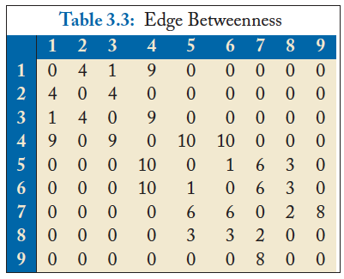
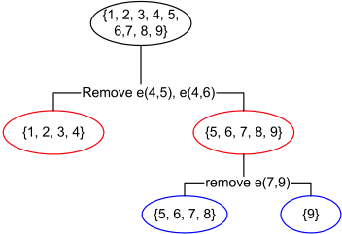
Divisive clustering based on edge betweenness
Initial betweenness value
After remove e(4,5), the betweenness of e(4, 6) becomes 20, which is the highest;
After remove e(4,6), the edge e(7,9) has the highest betweenness value 4, and should be removed.
Idea: progressively removing edges with the highest betweenness
46

Slide 47
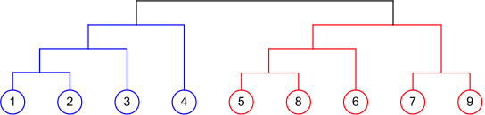
Agglomerative Hierarchical Clustering
47
Initialize each node as a community
Merge communities successively into larger communities following a certain criterion

Slide 48
Community Detection Algorithms
Graph partitioning Algorithm
The Clique Percolation Method
The Kernighan-Lin (KL) algorithm
Block Model Algorithm
Structural Similarity Algorithm
Edge Removal Algorithm
Randomized Algorithm
Notes:
Graph partitioning is iterative bisection: dividing the graph into 2 groups and then subdivide each group until we have the required # of groups.

Slide 49
What is a Random Walk?
Given a graph and a starting point (node), we select a neighbor of it at random, and move to this neighbor;
Then we select a neighbor of this node and move to it, and so on;
The (random) sequence of nodes selected this way is a random walk on the graph

Slide 50
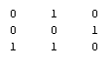
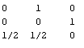
An example
A B C
A
B
C
Adjacency matrix A
Transition matrix P
B
1
1
1
1/2
1
1
A
1
C
1/2
Slide from Purnamitra Sarkar, Random Walks on Graphs: An Overview

Slide 51

An example
t=0, A
B
1
1/2
A
1
1/2
C
Slide from Purnamitra Sarkar, Random Walks on Graphs: An Overview

Slide 52
An example
t=0, A
t=1, AB
B
1
1
1/2
1/2
A
1
1
1/2
C
1/2
Slide from Purnamitra Sarkar, Random Walks on Graphs: An Overview

Slide 53

An example
t=0, A
t=1, AB
B
1
1
1/2
1/2
A
1
1
1/2
C
1/2
t=2, ABC
1
1/2
1
1/2
Slide from Purnamitra Sarkar, Random Walks on Graphs: An Overview

Slide 54


An example
t=0, A
t=1, AB
B
1
1
1/2
1/2
A
1
1
1/2
C
1/2
t=2, ABC
t=3, ABCA
ABCB
1
1/2
1
1
1/2
1
1/2
1/2
Slide from Purnamitra Sarkar, Random Walks on Graphs: An Overview

Slide 55
Random walk with restart
10
9
12
2
1
8
3
11
4
6
5
7

Slide 56
Random walk with restart
0.04
0.03
 | Node 4
Node 1 Node 2 Node 3 Node 4 Node 5 Node 6 Node 7 Node 8 Node 9 Node 10 Node 11 Node 12 | 0.13 0.10 0.13 0.22 0.13 0.05 0.05 0.08 0.04 0.03 0.04 0.02
10
0.10
9
12
0.13
2
0.08
0.02
1
8
0.13
11
3
0.04
4
0.05
6
5
0.13
7
0.05
Nearby nodes, higher scores
Ranking vector
More red, more relevant

Slide 57
Community Detection Algorithms
Graph partitioning Algorithm
The Clique Percolation Method
The Kernighan-Lin (KL) algorithm
Block Model Algorithm
Structural Similarity Algorithm
Edge Removal Algorithm
Randomized Algorithm

Slide 58
Measuring a clustering/community Result
1, 2, 3
4, 5, 6
1, 3
2
4, 5, 6
Ground Truth
Clustering Result
How to measure the
clustering quality?
The number of communities after grouping can be different from the ground truth
No clear community correspondence between clustering result and the ground truth
Notes:
58

Slide 59
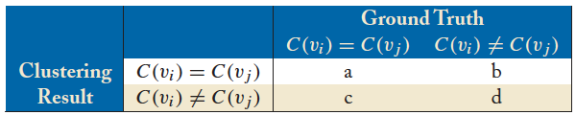
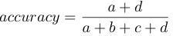
Accuracy of Pairwise Community Memberships
Consider all the possible pairs of nodes and check whether they reside in the same community
An error occurs if
Two nodes belonging to the same community are assigned to different communities after clustering
Two nodes belonging to different communities are assigned to the same community
Construct a contingency table or confusion matrix

Slide 60
Accuracy Example
1, 2, 3
4, 5, 6
1, 3
2
4, 5, 6
Ground Truth
Clustering Result
 |  | Ground Truth
 |  | C(v_{i}) = C(v_{j}) | C(v_{i}) != C(v_{j})
Clustering Result | C(v_{i}) = C(v_{j}) | 4 | 0
 | C(v_{i}) != C(v_{j}) | 2 | 9
Accuracy = (4+9)/ (4+2+9+0) = 13/15

Slide 61
Theory is when you know everything but nothing works.
Practice is when everything works but no one knows why.
In our lab, theory and practice are combined
nothing works and no one knows why

Slide 62

Information Diffusion in Social Networks

Slide 63

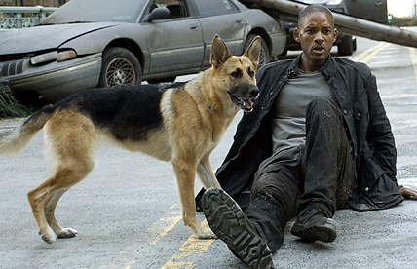

Slide 64
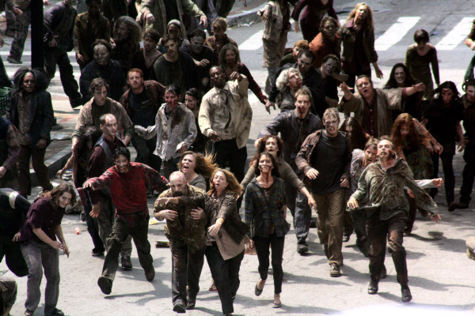

Slide 65


Slide 66

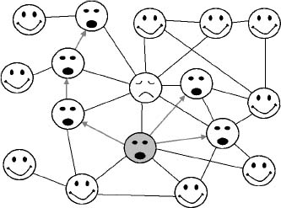
Information Diffusion and Epidemics

Slide 67
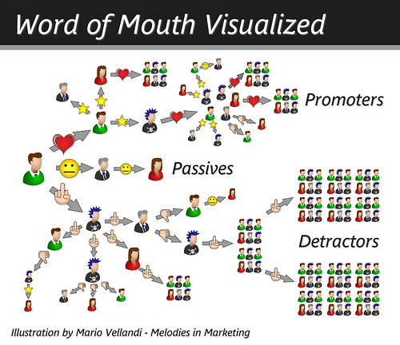
Social Network and Spread of Influence
Social network plays a fundamental role as a medium for the spread of INFLUENCE among its members
Opinions, ideas, information, innovation…
Notes:
67

Slide 68


Word-of-Mouth Marketing
To promote a product by seeding a few users; users adopting the product will recommend it
Advantages: efficient; cost-effective
Company
seed users
follow-up activated users
How to select the optimal seed users?
free product/
discount
influence

Slide 69
Problem Setting
Given
a limited budget B for initial advertising (e.g. give away free samples of product)
estimates for influence between individuals
Goal
trigger a large cascade of influence (e.g. further adoptions of a product)
Question
Which set of individuals should B target at?
Application besides product marketing
spread an innovation
Notes:
69
if we can try to convince a subset of individuals to adopt a new
product or innovation
But how should we choose the few key individuals to use for seeding this process?
Which blogs should one read to be most up to date?

Slide 70
Factors Influencing Diffusion
network structure (unweighted)
density
degree distribution
clustering
connected components
community structure
strength of ties (weighted)
frequency of communication
strength of influence

Slide 71
What we need
Form models of influence in social networks.
Obtain data about particular network (to estimate inter-personal influence).
Devise algorithm to maximize spread of influence.
Notes:
71

Slide 72
Linear Threshold Model
A node v has random threshold θ_{v} ~ U[0,1]
A node v is influenced by each neighbor w according to a weight b_{vw} such that
A node v becomes active when at least
(weighted) θ_{v} fraction of its neighbors are active
It must be true that all men say
Notes:
72
Given a random choice of thresholds, and an initial set of
active nodes A0 (with all other nodes inactive), the diffusion process
unfolds deterministically in discrete steps: in step t, all nodes
that were active in step t-1 remain active, and we activate any
node v for which the total weight of its active neighbors is at least
Theta(v)

Slide 73


Slide 74
Example
Inactive Node
0.5
0.6
Active Node
0.3
0.2
0.2
Threshold
X
Active neighbors
0.1
0.4
U
0.6
0.4
0.5
0.3
Stop!
0.2
w
0.5
v
0.3
Notes:
74

Slide 75
Independent Cascade Model
When node v becomes active, it has a single chance of activating each currently inactive neighbor w.
The activation attempt succeeds with probability p_{vw} .
Notes:
75
We again start with an initial set of active nodes A0, and the process unfolds in discrete steps according to
the following randomized rule. When node v first becomes active
in step t, it is given a single chance to activate each currently inactive
neighbor w; it succeeds with a probability pv;w —a parameter
of the system — independently of the history thus far. (If w has
multiple newly activated neighbors, their attempts are sequenced in
an arbitrary order.) If v succeeds, then w will become active in step
t+1; but whether or not v succeeds, it cannot make any further attempts
to activate w in subsequent rounds. Again, the process runs
until no more activations are possible.

Slide 76

Example
0.6
Inactive Node
0.3
0.2
0.2
Active Node
X
U
Newly active
node
0.1
0.4
Successful
attempt
0.5
0.3
0.2
Unsuccessful
attempt
w
0.5
v
Stop!
Notes:
76

Slide 77
Influence Maximization Problem
Influence of node set S: f(S)
– Given a set of initial nodes S, the expected
number of infected nodes at the end
• Problem
– Given a constant k, find a k‐node set S to
Maximize f(S)
– Constrained optimization problem with f(S)
as the objective function

Slide 78
Research Issues
Influence Models
Parameter Estimations
Big Data Issues
Theoretic Complexity

Slide 79
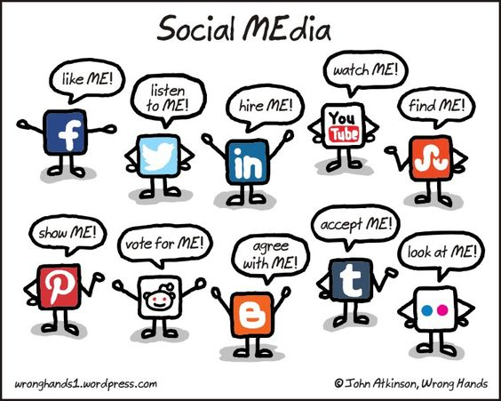

Slide 80
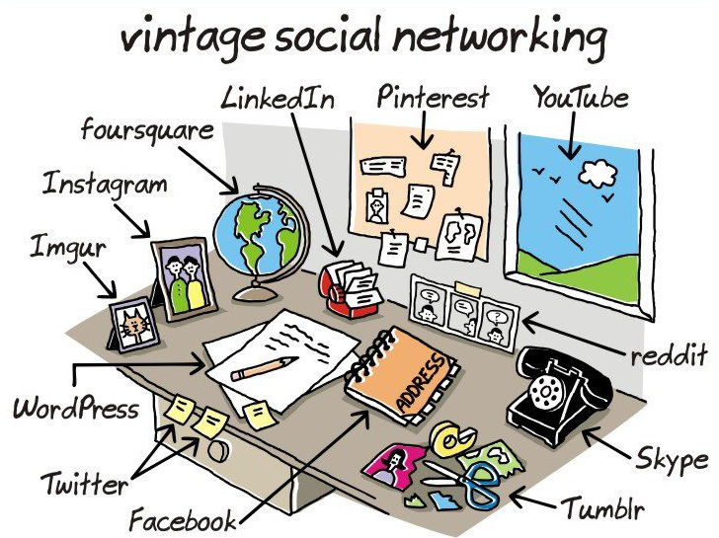

Slide 81
Trust and Distrust Propagation in Social Networks

Slide 82


Slide 83


Slide 84
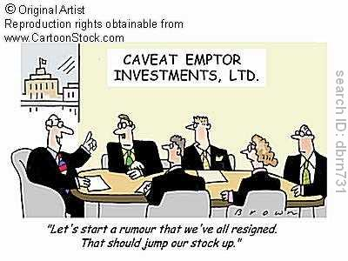
Background
Stock manipulation by bogus postings on investment boards

Slide 85


Background
Marketers posing as customers

Slide 86
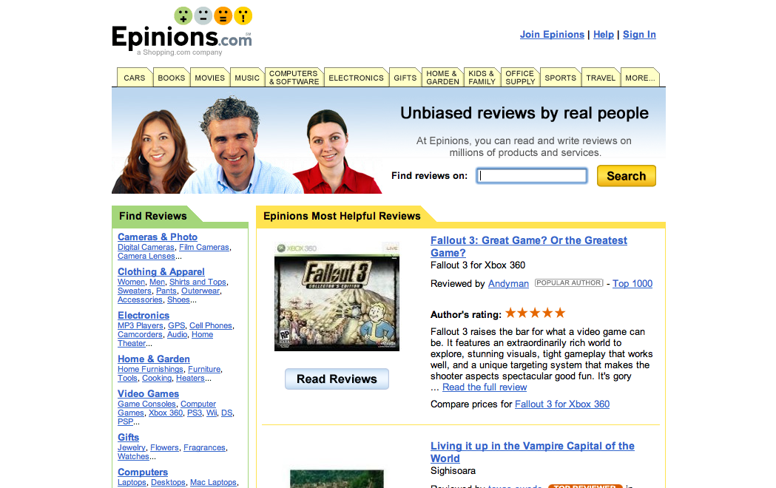
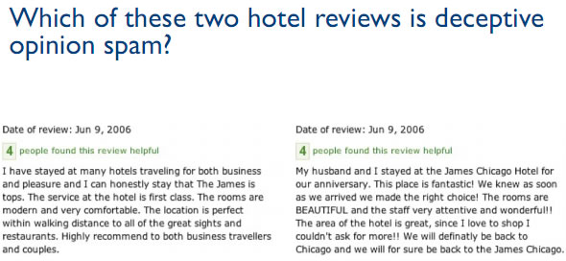
Problem Environment

Slide 87

台灣三星鵬泰驚人的騙術
http://www.inside.com.tw/2013/04/01/samsung-marketing-fraud

Slide 88
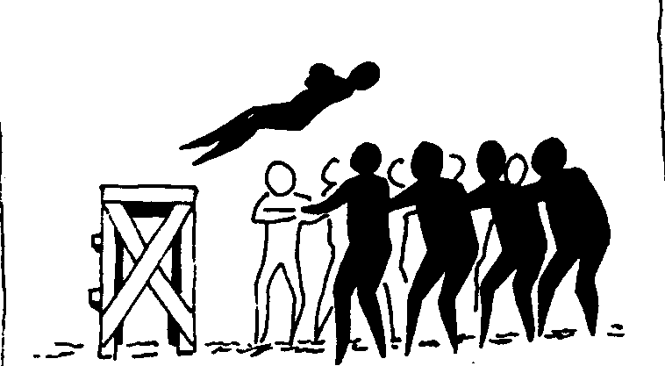
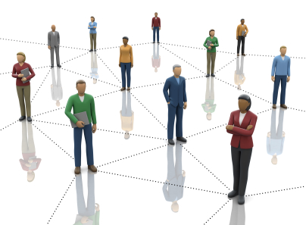
The basic idea
To build a trust network

Slide 89
Trust Data Sparseness
A few users with many trust relationships.
Majority users with few or no trust relationships.
Users may be lazy.
Users just don’t have many trusted friends.
A lack of trust relationships → difficulties in building useful applications.
Trust propagation

Slide 90
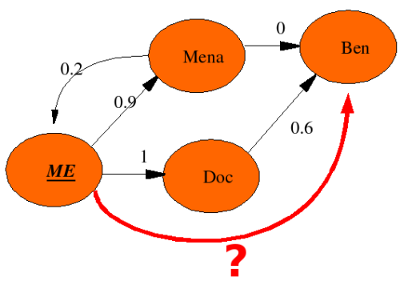
The main problem

Slide 91
Objective
A universe of n users
Goal: to predict unknown trust value between any two users

Slide 92
The proposed ideas
1
2
3
1
2
5
3
4
Basic propagation techniques
4 basic atoms
Direct Propagation
Co-citation
Transpose Trust
Trust coupling

Slide 93
Atomic Propagation (2)
1
2
3
0 | 1 | 0
0 | 0 | 1
0 | 0 | 0
0 | 1 | 0
0 | 0 | 1
0 | 0 | 0
0 | 0 | 1
0 | 0 | 0
0 | 0 | 0
₌
Direct Propagation, B
Co-citation, B^{T}B
Transpose Trust, B^{T}
Trust coupling, BB^{T}

Slide 94
Co-citation, B^{T}B
1
2
3
4
B
B^{T}
BB^{T}
0 | 1 | 0 | 1
0 | 0 | 0 | 0
0 | 0 | 0 | 1
0 | 0 | 0 | 0
0 | 0 | 0 | 0
1 | 0 | 0 | 0
0 | 0 | 0 | 0
1 | 0 | 1 | 0
2 | 0 | 1 | 0
0 | 0 | 0 | 0
1 | 0 | 1 | 0
0 | 0 | 0 | 0
₌
2 | 0 | 1 | 0
0 | 0 | 0 | 0
1 | 0 | 1 | 0
0 | 0 | 0 | 0
0 | 1 | 0 | 1
0 | 0 | 0 | 0
0 | 0 | 0 | 1
0 | 0 | 0 | 0
0 | 2 | 0 | 4
0 | 0 | 0 | 0
0 | 1 | 0 | 2
0 | 0 | 0 | 0
₌
BB^{T}
B
BB^{T}B

Slide 95
Trust Coupling, BB^{T}
1
5
3
4
B
B
BB
0 | 0 | 0 | 1 | 0
0 | 0 | 0 | 0 | 0
0 | 0 | 0 | 1 | 0
0 | 0 | 0 | 0 | 0
0 | 0 | 1 | 0 | 0
0 | 0 | 0 | 1 | 0
0 | 0 | 0 | 0 | 0
0 | 0 | 0 | 1 | 0
0 | 0 | 0 | 0 | 0
0 | 0 | 1 | 0 | 0
0 | 0 | 0 | 0 | 0
0 | 0 | 0 | 0 | 0
0 | 0 | 0 | 0 | 0
0 | 0 | 0 | 0 | 0
0 | 0 | 0 | 1 | 0
₌
0 | 0 | 0 | 0 | 0
0 | 0 | 0 | 0 | 0
0 | 0 | 0 | 0 | 0
0 | 0 | 0 | 0 | 0
0 | 0 | 0 | 1 | 0
0 | 0 | 0 | 0 | 0
0 | 0 | 0 | 0 | 0
0 | 0 | 0 | 0 | 1
1 | 0 | 1 | 0 | 0
0 | 0 | 0 | 0 | 0
0 | 0 | 0 | 0 | 0
0 | 0 | 0 | 0 | 0
0 | 0 | 0 | 0 | 0
0 | 0 | 0 | 0 | 0
1 | 0 | 1 | 0 | 0
₌
BB
B^{T}
BBB^{T}

Slide 96
Atomic Propagation
=
+
+ … + …
B
B
B^{T}B
Direct Propagation, B
Co-citation, B^{T}B
Transpose Trust, B^{T}
Trust coupling, BB^{T}

Slide 97
Give the distrust assignment
”Negative Trust”
-
-

Slide 99
On The Transitivity of Distrust
distrusts
distrusts
i
j
k
distrusts?

Slide 100
On The Transitivity of Distrust
Multiplicative Distrust creates problems
As seen on previous slide:
”Enemy of my enemy is my friend”
Directed cycle with negative values can lead to the user to distrust himself!
Additive Distrust Propagation
Transform the basic propagation atom
For example exp(b_{ij}) → b_{ij}
Open Problem !

Slide 101
Privacy Preserving in Social Networks

Slide 102
A running example
Preserving privacy in publishing social networks by removing the names of vertexes ?

Slide 103
Issues in preserving privacy in social networks
Privacy in social networks
Identifications of individuals
Adversary ability
Passive Attacks
Degree attacks, Neighborhood attacks
Active Attacks
Planted structure
The goal of preserving the privacy
K-anonymity (G→G’)
Usage of anonymized social network
Minimizing the effects over network parameters, e.g. diameter, degree distribution

Slide 104
Suppose that we know…
Alice had three sexual contacts
Bob and Cathy had four sexual contacts
Alice and Cathy had a great night together
Cathy had two close friends knowing each other

Slide 105
K-anonymity:
Even with the neighborhood background
knowledge, any vertex in G cannot be re-identified in G’
with confidence larger than 1/k
1. Alice had three sexual contacts
Bob and Cathy had four sexual contacts
Alice and Cathy had a great night together
Cathy had two close friends knowing each other

Slide 106
Problem:
providing k-anonymous,
while minimizing
Difference |G-G’|
G’
G’’’
G
G’’

Slide 107
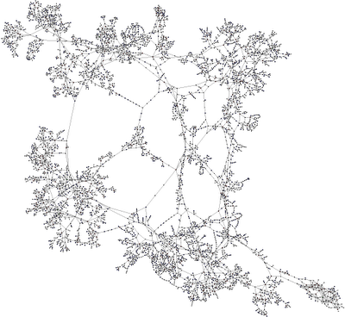
Challenges
For neighborhood attacks, it is very challenge to find the weak points
The graph isomorphism problem

Slide 108
Active Attacks
Use random graph model to produce an unique structure [1]

Slide 109
Active Attacks

Slide 110
Research Issues
Community Analysis
Trust and Distrust Propagation
Privacy Preserving
Information Diffusion
Link Analysis

Slide 111
Link-Analysis

Slide 112
Brief History of the Web
Yahoo!
Google
Badoo
Microsoft
Bing
Infoseek
?
Web
Openfind
AltaVista
1990
1995
1998
2000
2008
2016

Slide 113
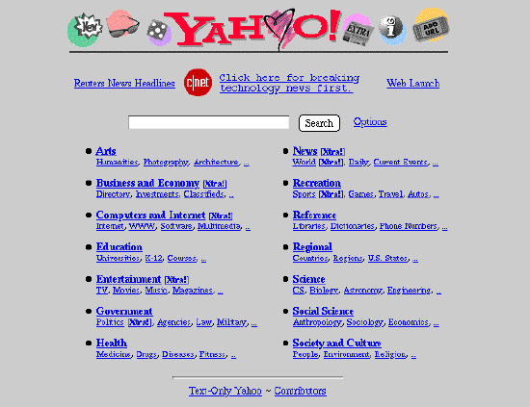
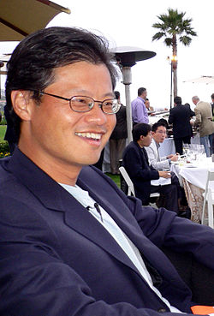

Let’s go back to 1995 …

Slide 114
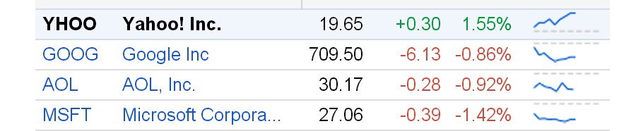
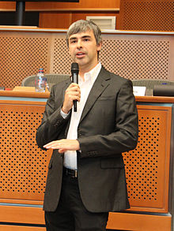
Google Search Engine at 1997

Slide 115




Efficiency
Effectiveness

Slide 116

Page Rank Algorithm

Slide 117
Introduction on PageRank
PageRank is a link analysis algorithm … with the purpose of "measuring" its (Webpage) relative importance within the set.
– From Wikipedia, the free encyclopedia
Developed by Larry Page as his PhD research topic
3 years later, he quitted Stanford and founded Google with Brin (1998)
He lost his PhD qualification. In return, his net worth now is …

Slide 118




Slide 119
From the content analysis view
Web

Slide 120
From the link analysis view
Web

Slide 121
The problem
What is the most important node in the following graph ?

Slide 122

Using popularity as measure
Each page gets a static score = the number of in-links plus the number of out-links.
Static score of a page = number of its in-links.
How do you spam each of the following heuristics so your page gets a high score?

Slide 123
Ranking web pages
Web pages are not equally “important”
www.joe-schmoe.com v www.stanford.edu
Inlinks as votes
www.stanford.edu has 23,400 inlinks
www.joe-schmoe.com has 1 inlink
Are all inlinks equal?
Recursive question!

Slide 124

PageRank: Defined (1/2)
Each link’s vote is proportional to the importance of its source page
If page P with importance x has n outlinks, each link gets x/n votes
Page P’s own importance is the sum of the votes on its inlinks

Slide 125



PageRank: Defined (2/2)
PageRank = Importance of the Webpage
Concept is simple:
20
20
20
Bloomberg
PageRank=60
PageRank=
20+10 = 30
10

Slide 126
Simple “flow” model
y = y /2 + a /2
a = y /2 + m
m = a /2
Yahoo
y/2
y
a/2
y/2
m
Amazon
M’soft
a/2
a
m

Slide 127
Solving the flow equations
3 equations, 3 unknowns, no constants
No unique solution
Additional constraint forces uniqueness
y+a+m = 1
y = 2/5, a = 2/5, m = 1/5
Gaussian elimination method works for small examples, but we need a better method for large graphs

Slide 128
Matrix formulation
Matrix M has one row and one column for each web page
Suppose page j has n outlinks
If j → i, then M_{ij}=1/n
Else M_{ij}=0
M is a column stochastic matrix
Columns sum to 1
Suppose r is a vector with one entry per web page
r_{i} is the importance score of page i
Call it the rank vector

Slide 129
Example
y a m
Yahoo
y 1/2 1/2 0
a 1/2 0 1
m 0 1/2 0
r = Mr
Amazon
M’soft
y 1/2 1/2 0 y
a = 1/2 0 1 a
m 0 1/2 0 m
y = y /2 + a /2
a = y /2 + m
m = a /2

Slide 130
Power Iteration method
Simple iterative scheme (aka relaxation)
Suppose there are N web pages
Initialize: r⁰ = [1/N,….,1/N]^{T}
Iterate: r^{k+1} = Mr^{k}
Stop when |r^{k+1} - r^{k}|₁ < ε

Slide 131
Power Iteration Example
Yahoo
y a m
y 1/2 1/2 0
a 1/2 0 1
m 0 1/2 0
Amazon
M’soft
y
a =
m
1/3
1/3
1/3
1/3
1/2
1/6
5/12
1/3
1/4
3/8
11/24
1/6
2/5
2/5
1/5
. . .

Slide 132


Slide 133
Random Walk Interpretation (1/2)
Imagine a browser doing a random walk on web pages:
Start at a random page
At each step, go out of the current page along one of the links on that page, equiprobably
“In the steady state” each page has a long-term visit rate - use this as the page’s score.
1/3
1/3
1/3

Slide 134
Random Walk Interpretation (2/2)
Imagine a random web surfer
At any time t, surfer is on some page P
At time t+1, the surfer follows an outlink from P uniformly at random
Ends up on some page Q linked from P
Process repeats indefinitely
Let p(t) be a vector whose i^{th} component is the probability that the surfer is at page i at time t
p(t) is a probability distribution on pages

Slide 135
Power Iteration Example
Yahoo
y a m
y 1/2 1/2 0
a 1/2 0 1
m 0 1/2 0
Amazon
M’soft
y
a =
m
1/3
1/3
1/3
1/3
1/2
1/6
5/12
1/3
1/4
3/8
11/24
1/6
2/5
2/5
1/5
. . .

Slide 136
The stationary distribution
Where is the surfer at time t+1?
Follows a link uniformly at random
p(t+1) = Mp(t)
Suppose the random walk reaches a state such that p(t+1) = Mp(t) = p(t)
Then p(t) is called a stationary distribution for the random walk
Our rank vector r satisfies r = Mr
So it is a stationary distribution for the random surfer

Slide 137
Existence and Uniqueness
A central result behind the Page Rank algorithm:
For graphs that satisfy certain conditions, the stationary distribution/steady state is unique and eventually will be reached no matter what the initial probability distribution at time t = 0.

Slide 138
Steady state example
The steady state looks like a vector of probabilities a = (a₁, … a_{n}):
a_{i} is the probability that we are in state i.
3/4
1/4
1
2
3/4
1/4
For this example, a₁=1/4 and a₂=3/4.

Slide 139
Ergodic Markov chains
A Markov chain is ergodic if
you have a path from any state to any other
For any start state, after a finite transient time T₀, the probability of being in any state at a fixed time T>T₀ is nonzero.
Not
ergodic

Slide 140
Spider traps
A group of pages is a spider trap if there are no links from within the group to outside the group
Random surfer gets trapped
Spider traps violate the conditions needed for the random walk theorem

Slide 141
Microsoft becomes a spider trap
Yahoo
y a m
y 1/2 1/2 0
a 1/2 0 0
m 0 1/2 1
Amazon
M’soft
y
a =
m
1
1
1
1
1/2
3/2
3/4
1/2
7/4
5/8
3/8
2
0
0
3
. . .

Slide 142
Random teleports
The Google solution for spider traps
At each time step, the random surfer has two options:
With probability β, follow a link at random
With probability 1-β, jump to some page uniformly at random
Common values for β are in the range 0.8 to 0.9
Surfer will teleport out of spider trap within a few time steps

Slide 143
Random teleports (β = 0.8)
0.2*1/3
y
y
y
1/2
Yahoo
y 1/2
a 1/2
m 0
1/2
1/2
0
1/3
1/3
1/3
0.8*1/2
0.8*
+ 0.2*
1/2
0.8*1/2
0.2*1/3
0.2*1/3
1/2 1/2 0
1/2 0 0
0 1/2 1
1/3 1/3 1/3
1/3 1/3 1/3
1/3 1/3 1/3
Amazon
M’soft
0.8
+ 0.2
y 7/15 7/15 1/15
a 7/15 1/15 1/15
m 1/15 7/15 13/15

Slide 144
Random teleports (β = 0.8)
1/2 1/2 0
1/2 0 0
0 1/2 1
1/3 1/3 1/3
1/3 1/3 1/3
1/3 1/3 1/3
Yahoo
0.8
+ 0.2
y 7/15 7/15 1/15
a 7/15 1/15 1/15
m 1/15 7/15 13/15
Amazon
M’soft
y
a =
m
1
1
1
1.00
0.60
1.40
0.84
0.60
1.56
0.776
0.536
1.688
7/11
5/11
21/11
. . .

Slide 145
Matrix formulation
Suppose there are N pages
Consider a page j, with set of outlinks O(j)
We have M_{ij} = 1/|O(j)| when j→i and M_{ij} = 0 otherwise
The random teleport is equivalent to
adding a teleport link from j to every other page with probability (1-β)/N
reducing the probability of following each outlink from 1/|O(j)| to β/|O(j)|
Equivalent: tax each page a fraction (1-β) of its score and redistribute evenly

Slide 146
Dead ends
The web is full of dead-ends.
Random walk can get stuck in dead-ends.
Makes no sense to talk about long-term visit rates.
Pages with no outlinks are “dead ends” for the random surfer
Nowhere to go on next step
??

Slide 147
Microsoft becomes a dead end
1/2 1/2 0
1/2 0 0
0 1/2 0
1/3 1/3 1/3
1/3 1/3 1/3
1/3 1/3 1/3
Yahoo
0.8
+ 0.2
y 7/15 7/15 1/15
a 7/15 1/15 1/15
m 1/15 7/15 1/15
Amazon
M’soft
Non-
stochastic!
y
a =
m
1
1
1
1
0.6
0.6
0.787
0.547
0.387
0.648
0.430
0.333
0
0
0
. . .

Slide 148
Dealing with dead-ends
Teleport
Follow random teleport links with probability 1.0 from dead-ends
Adjust matrix accordingly
Prune and propagate
Preprocess the graph to eliminate dead-ends
Might require multiple passes
Compute page rank on reduced graph

Slide 149
Page Rank
Construct the N*N matrix A as follows
A_{ij} = βM_{ij} + (1-β)/N
Verify that A is a stochastic matrix
The page rank vector r is the principal eigenvector of this matrix
satisfying r = Ar
Equivalently, r is the stationary distribution of the random walk with teleports

Slide 150

PageRank Idea

Slide 151
Link-Analysis
Hyperlink-Induced Topic Search

Slide 152
Hyperlink-Induced Topic Search (HITS)
Interesting nodes fall into two classes
Authorities are pages containing useful information
course home pages
home pages of auto manufacturers
Hubs are pages that link to authorities
course bulletin
list of US auto manufacturers

Slide 153
Idealized view
Hubs
Authorities

Slide 154
The hope
Authorities
Hubs
Long distance telephone companies

Slide 155
Mutually recursive definition
A good hub links to many good authorities
A good authority is linked from many good hubs
Model using two scores for each node
Hub score and Authority score
Represented as vectors h and a

Slide 156
Iterative update
Repeat the following updates, for all x:
x
x

Slide 157
Transition Matrix A
HITS uses a matrix A[i, j] = 1 if page i links to page j, 0 if not
A^{T}, the transpose of A, is similar to the PageRank matrix M, but A^{T} has 1’s where M has fractions

Slide 158
Example
y a m
Yahoo
y 1 1 1
a 1 0 1
m 0 1 0
A =
Amazon
M’soft

Slide 159
Hub and Authority Equations
The hub score of page P is proportional to the sum of the authority scores of the pages it links to
h = λAa
Constant λ is a scale factor
The authority score of page P is proportional to the sum of the hub scores of the pages it is linked from
a = μA^{T} h
Constant μ is scale factor

Slide 160
Scaling
To prevent the h and a values from getting too big, can scale down after each iteration.
Scaling factor doesn’t really matter:
we only care about the relative values of the scores.

Slide 161
Iterative algorithm
Initialize h, a to all 1’s
h = Aa
Scale h so that its max entry is 1.0
a = A^{T}h
Scale a so that its max entry is 1.0
Continue until h, a converge

Slide 162
Example
h = Aa
a = A^{T}h
1 1 1
A = 1 0 1
0 1 0
1 1 0
A^{T} = 1 0 1
1 1 0
a(yahoo)
a(amazon)
a(m’soft)
=
=
=
1
1
1
1
1
1
1
4/5
1
1
0.75
1
. . .
. . .
. . .
1
0.732
1
h(yahoo) = 1
h(amazon) = 1
h(m’soft) = 1
1
2/3
1/3
1
0.71
0.29
1
0.73
0.27
. . .
. . .
. . .
1.000
0.732
0.268

Slide 163
Existence and Uniqueness
h = λAa
a = μA^{T} h
h = λμAA^{T} h
a = λμA^{T}A a
Under reasonable assumptions about A,
the dual iterative algorithm converges to vectors
h* and a* such that:
h* is the principal eigenvector of the matrix AA^{T}
a* is the principal eigenvector of the matrix A^{T}A

Slide 164
Page Rank and HITS
Page Rank and HITS are two solutions to the same problem
What is the value of an inlink from S to D?
In the page rank model, the value of the link depends on the links into S
In the HITS model, it depends on the value of the other links out of S
The destinies of Page Rank and HITS post-1998 were very different
Why?

